Slide 1

Individual Digital Solution
976860W

Slide 2

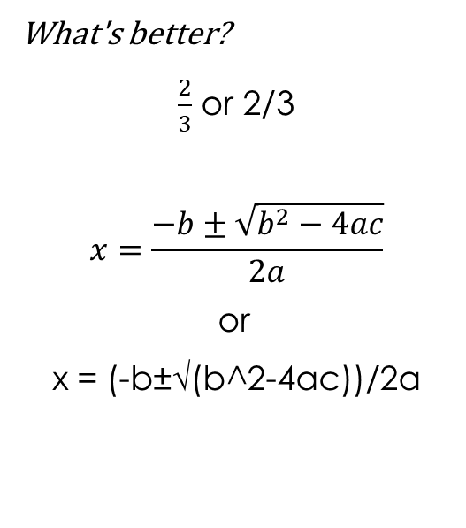
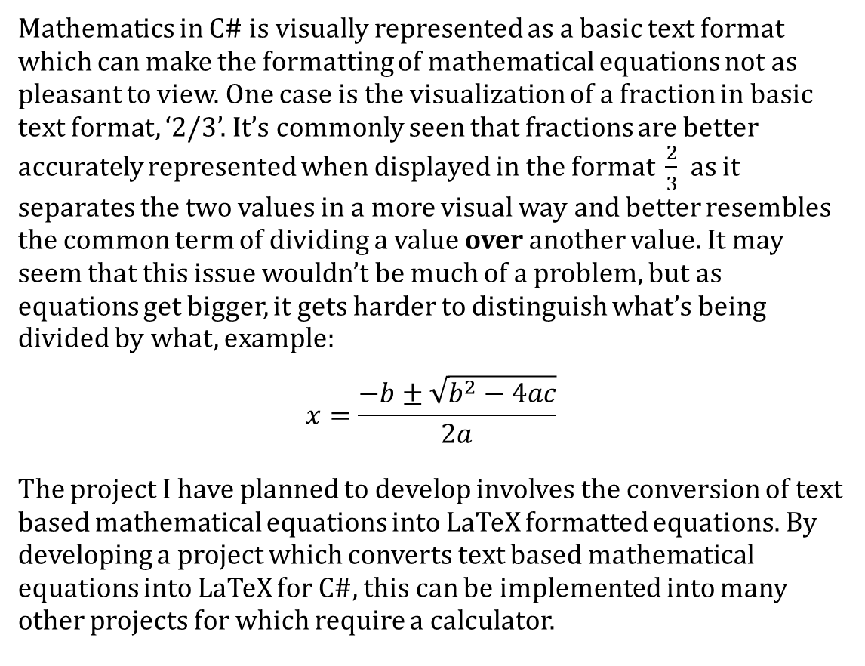
Identifying the Problem
Mathematics in C# is visually represented as a basic text format which can make the formatting of mathematical equations not as pleasant to view. One case is the visualization of a fraction in basic text format, ‘2/3’. It’s commonly seen that fractions are better accurately represented when displayed in the format $\frac{2}{3}$ as it separates the two values in a more visual way and better resembles the common term of dividing a value over another value. It may seem that this issue wouldn’t be much of a problem, but as equations get bigger, it gets harder to distinguish what’s being divided by what, example:
$$x=\frac{−b±\sqrt{b^{2}−4ac}}{2a}$$
The project I have planned to develop involves the conversion of text based mathematical equations into LaTeX formatted equations. By developing a project which converts text based mathematical equations into LaTeX for C#, this can be implemented into many other projects for which require a calculator.
What's better?
$\frac{2}{3}$ or 2/3
$$x=\frac{−b±\sqrt{b^{2}−4ac}}{2a}$$
or
x = (-b±√(b^2-4ac))/2a

Slide 3
Identifying the Stakeholder
The projects stakeholder is the Year 11 coordinator for Tyndale Christian School who is a mathematics teacher for Stage 2 Math methods and other Stage 1 math classes. The client has a wide knowledge involving mathematics and is passionate about the subject which is helpful in developing further improvements and features of the application.
The client’s reasoning behind supporting this project is that the client is in the process of developing an education mathematics app which the client plans to use for strengthening the student’s mathematics comprehension. For this application to be affective, the mathematics needs to be visually accurate which is where my project helps the client in doing so.

Slide 4
Project Plan
The timescale for developing this application is 9 weeks consisting of around 40 and a half hours of time dedicated to this project in class and however much longer at home. Initially the project was planned to be developed as a Windows Form App in visual studio, but it was found that the LaTeX conversion library which I planned to use is not compatible with this .Net format. Hence the project will be developed in visual studio 2017 as a Windows
Presentation Form App (WPF) which I have no previous experience with using. The main key feature to be created is the overall conversion from basic text format to LaTeX format, after this feature is complete, the client can recommend further improvements or additions to the calculator. A feature planned to be developed as well is a graphing mode which allows for the graphing of multiple functions and finding interceptions of these functions.

Slide 5
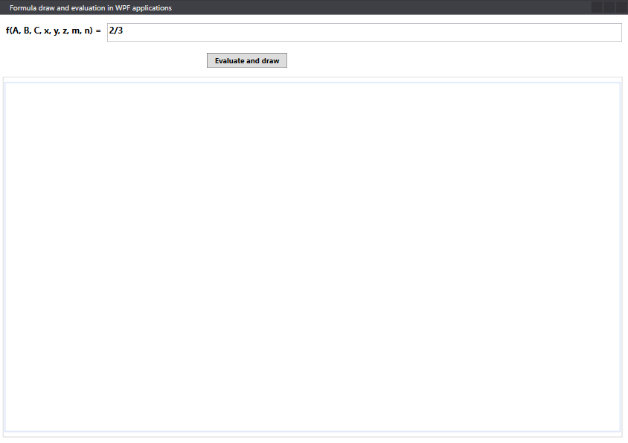
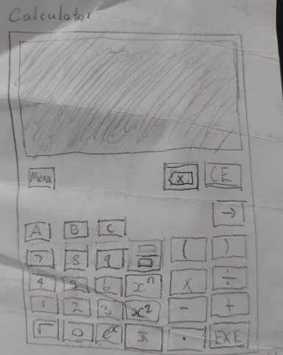
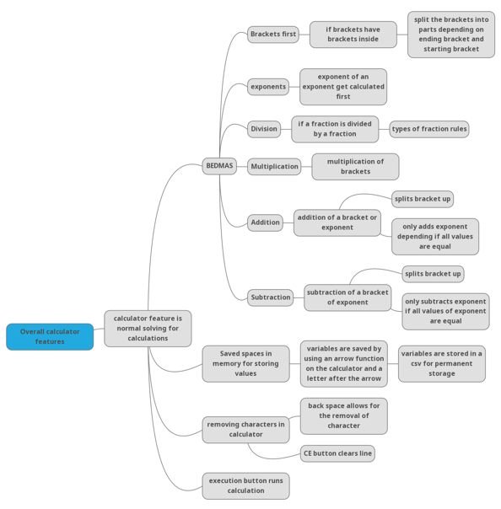
Initial Design and thought process
The initial design of the calculator is based on a wpf-math example application developed by ForNeVeR and pushed to the wpf-math library on github. The initial design involves the conversion of an equation that the user has entered in a text box when the Execute button is clicked. For what is initially known, the process of converting should just require the change from initial basic text to LaTeX text. Hence the main part of the initial application will be making sure that the equation that the user enters is valid for conversion to LaTeX formation. Invalid equations could include unrecognized symbols or languages or just the incorrect formation of a math equation. The sketch represents the initial design thought of the GUI for the calculator. The mind map goes through my process of different types of features to include for the calculator such as extra variables, a graphing mode, and an equating mode.
Example application

Slide 6
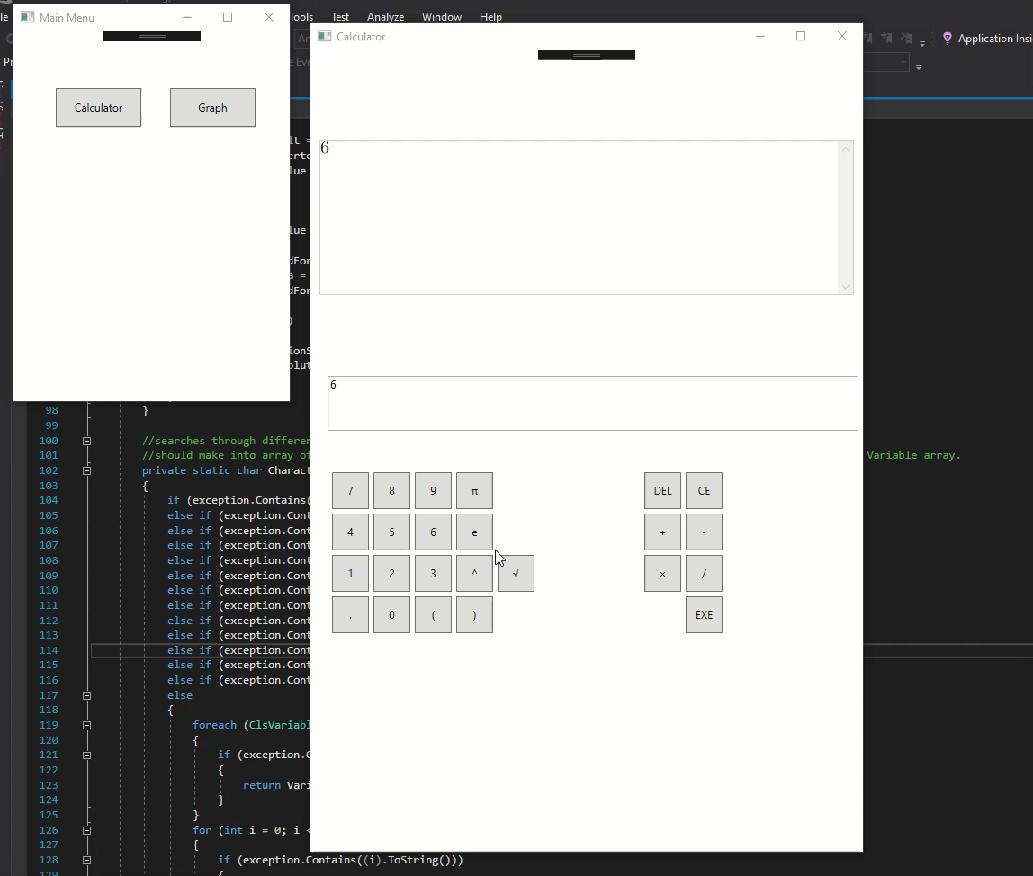
Application

Slide 7
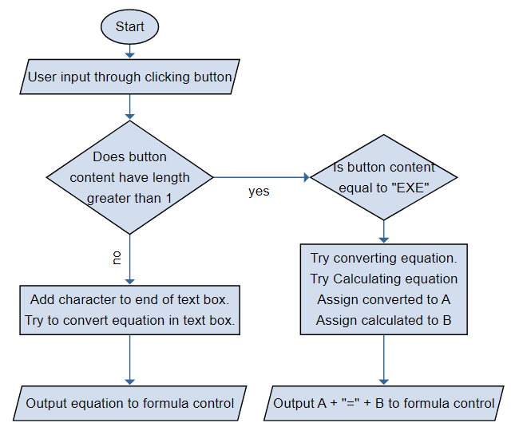
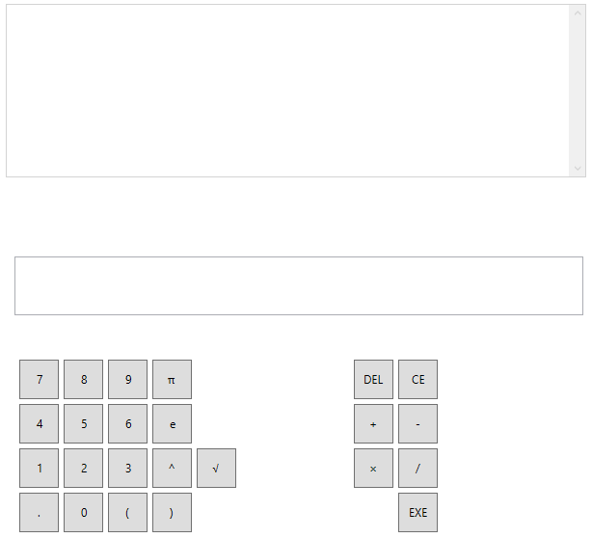
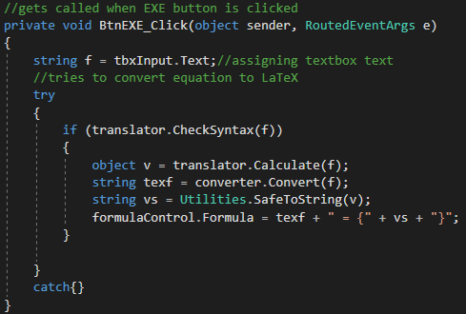
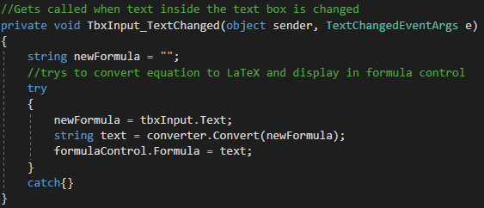
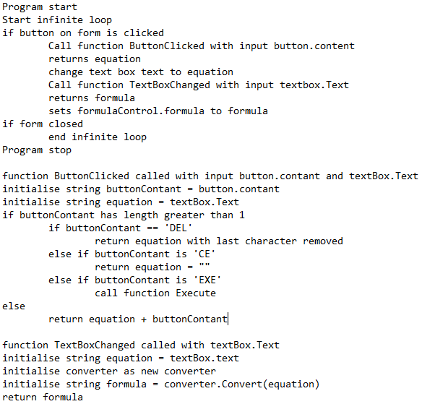
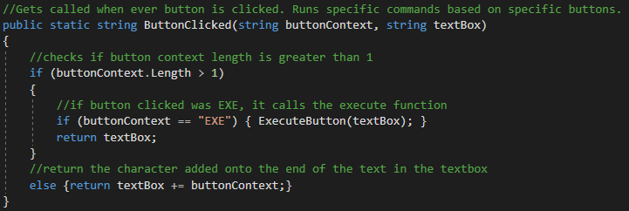
Iteration 1
Initially, the equation for which the user is typing only gets displayed when the user clicks the execute button. It has now been changed so that the user is only able to add specific characters to the text box as the user is now limited to inputting characters through their respective button. This reduces the chance of a conversion error occurring as only known characters can be added to the text box. On top of this, a feature has been implemented so that when the user adds a character to the text box it automatically tries to convert the equation to the LaTeX format. This was recommended by the client as it was more preferable for the calculator to be visually interactive. A new function was created called ButtonClicked, this function is called whenever the user clicks on any of the buttons. This method is more efficient as it uses a single function for when a button is clicked instead of individual functions for each button.

Slide 8
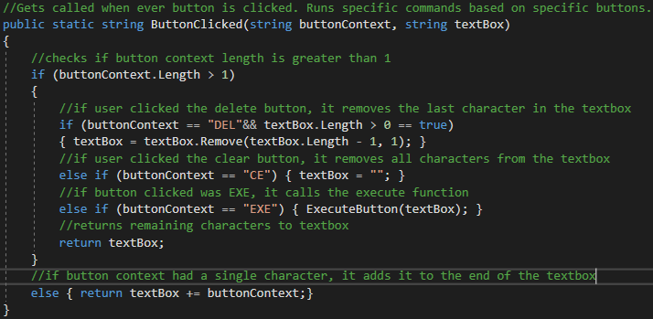
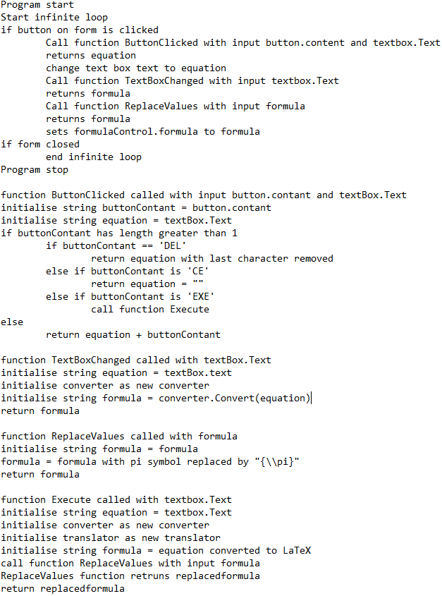
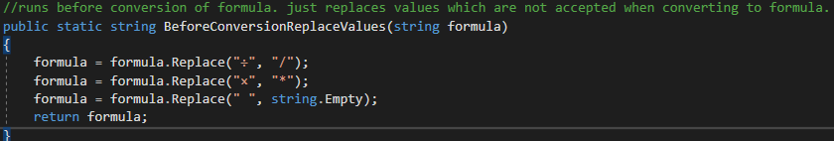
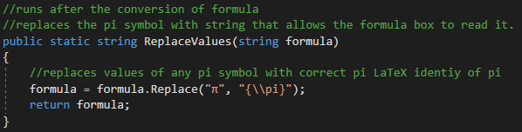
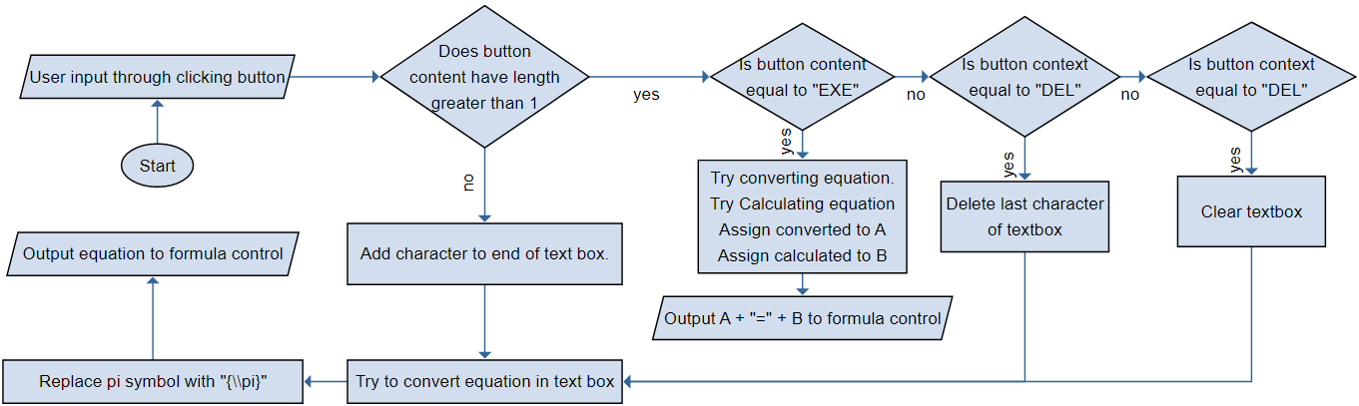
Iteration 2
It was found that when the pi symbol is added to the text box, it would fail to appear in the formula control box which holds the LaTeX converted equation. Through using debug, it was found that when pi is displayed in LaTeX, it has a specific identity to represent pi. To help with problem solving, I used pseudo code and a flow chart to plan a solution. To fix this problem, a function called Replace Values was created to replace the pi symbol with its respective LaTeX identity after the conversion has taken place. The use of a function for replacing pi is an effective solution as if more issues similar are found, they can be added to the function. On top of this, a delete and clear feature was added allowing for the user to delete the most recent added character or clear the entire equation.

Slide 9
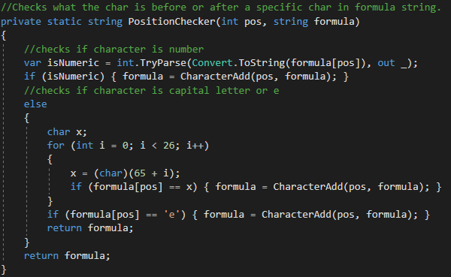
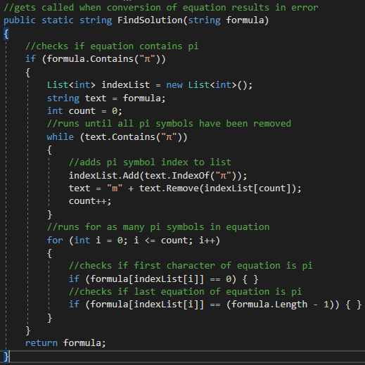
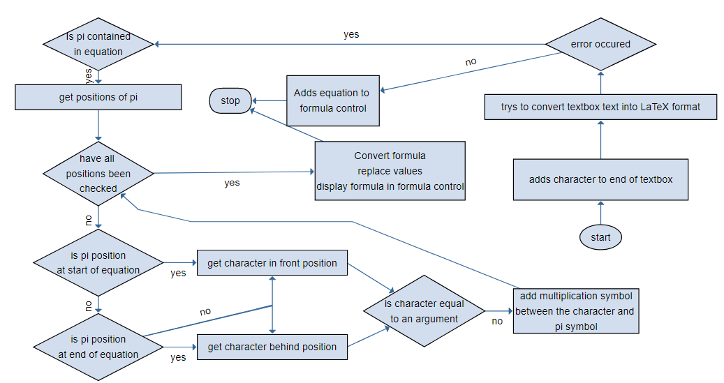
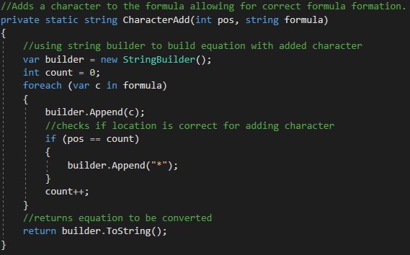
Iteration 3
From using the pi symbol in the equation, it was found that when you try to display a number next to the pi symbol, it will output nothing in the formula control. This indicates an error with the conversion checker. Using the debug, it was found that as the equation did not have a multiplication symbol in between the number and the pi symbol, it was not indicating that the two values are being multiplied and causes an error to occur in displaying the formula. Before thinking of a solution, I created a new class called Conversion_Checker as it was found that to display the formula in LaTeX format, it will require the equation syntax to change to allow for the conversion to occur. I moved some of the functions initially created to this class for ease of access from other forms as it will be more efficient for when other features are created which will use the same aspects of the calculator form.
To find a solution to the number next to the pi symbol, I created a flowchart to evaluate a solution. The flowchart shows the implantation of new functions to help with formatting the equations syntax correctly. In the TextChanged function, it now tries to convert the equation and if it fails, it calls a function called FindSolution from the Conversion_Checker class. This function than finds the positions of the pi symbol in the equation and stores these positions in an index list. The use of a list saves the amount of memory used by the app as its unknown how many indexes there are. Using an array would mean initializing it with a large number of reserved spaces in memory which may not even get used. After the indexes of pi are found, the function than checks whether the character behind or in front of the index is a special argument character, such as ‘*’, ‘/’, ‘+’, or ‘- ‘, otherwise it will add a multiplication symbol in between the pi symbols index and behind or in fronts character. After changing the syntax of the equation, it tries to convert the equation and returns the equation back to the form. The form than adds the equation to the formula control allowing for the view of the equation in LaTeX formation. This solution will be used for the exponential character as well.

Slide 10
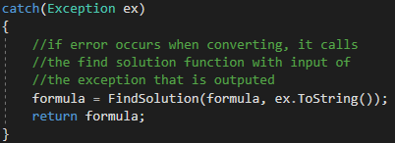
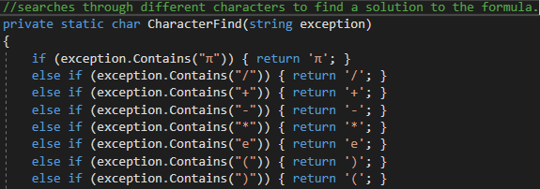
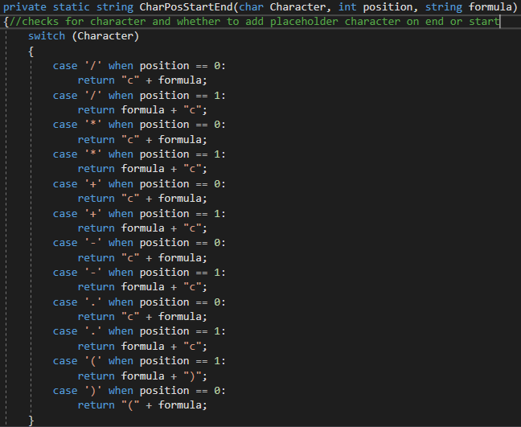
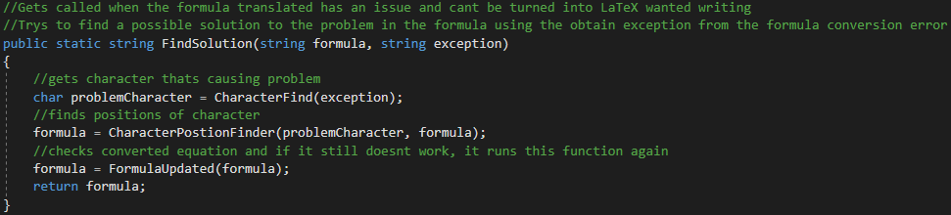
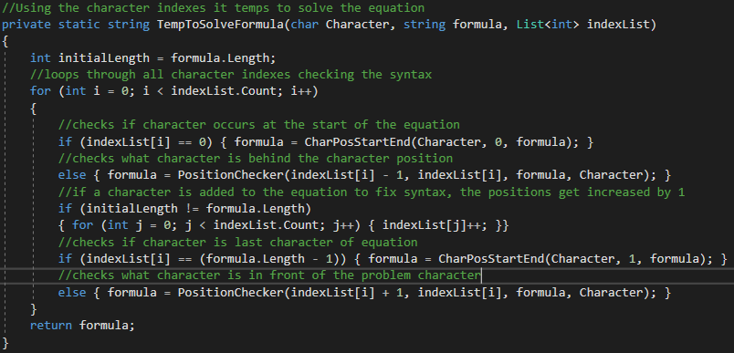
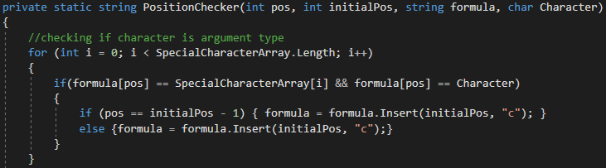
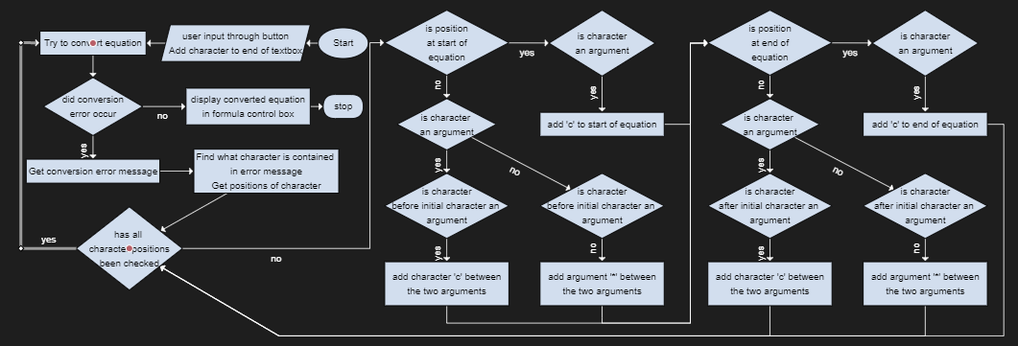
Iteration 4
It was found that when the user is midway through typing an equation the convertor will cause an error to occur as it is unable to convert ‘3+’ as it is an incomplete equation. To fix this solution, the plan is to add a character on the end of the equation and convert it than remove it afterwards to output it to the formula control. This type of error could occur for any of the major arguments like ‘*’, ‘+’, ‘- ‘, ‘/’, ‘.’, and ‘^’ and could occur in front of the equation as well. These arguments are added to char array for efficiency when finding certain characters. When the conversion error occurs, it outputs an exception message which explains the issue. To find what character is included within the conversion error, a new function needs to be created to find what characters are contained in the exception. The flowchart shows how the function checks wither the exception contains a specific character, if it does, then it returns the specific character. Previously the indexes of pi were found from the FindSolution function in the Conversion_Checker class, the indexes were then used to find what characters appear in front and behind all pi symbols within the equation. A function called CharacterIndexes is created to find the character indexes for the specific problem. It acts works the same way as the previous position finder for the pi symbol but now can take any character and find its positions in the equation. It then returns a List of the character indexes to use in correcting the syntax of the equation. The creation of this function is more effective than going through multiple different character index finders. The second flowchart describes the steps of a new function called CharacterSolutionFinder which fixes the syntax based on where the characters are located. It checks whether the character next to the problem character is a number or special character and then inserts the required character in between the two characters. After it runs through all character positions, it tries converting again and if an error occurs again, it will run through the code again but this time the issue will be different.
Add flowchart

Slide 11
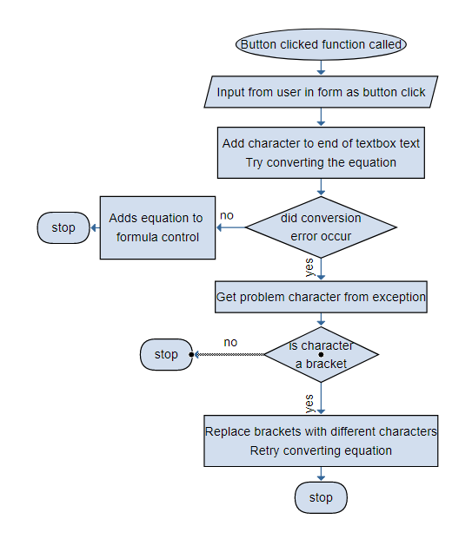
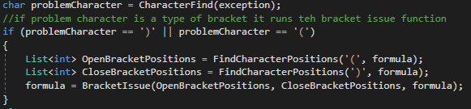
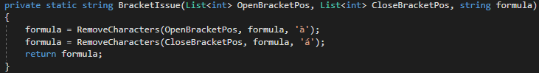
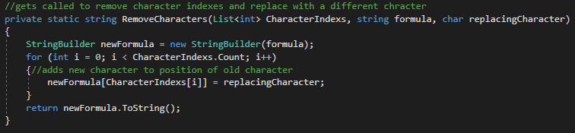
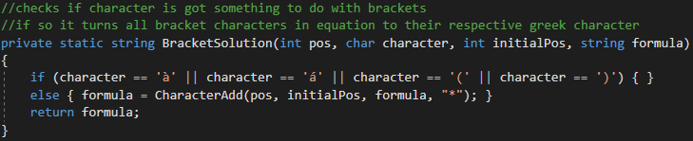
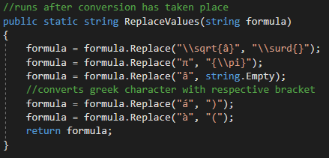
Iteration 5
When the user introduced brackets into the mix, it was found that a whole bunch of errors occurred with the converting. When brackets are used in LaTeX, they must be used in the pair of a left bracket and right bracket. This becomes an issue when the user is still typing the equation as it is not a pair and causes the conversion to be an error. A flowchart is created to plan a solution to get around this problem. The flowchart explains the purposes of the new functions created. One function is called BracketIssue and only got called if the problem character within the exception error was a bracket. This function would get the positions of all left and right brackets and replace them with à and á respectively. These characters were than replaced with the respective type of bracket after the conversion occurred.

Slide 12
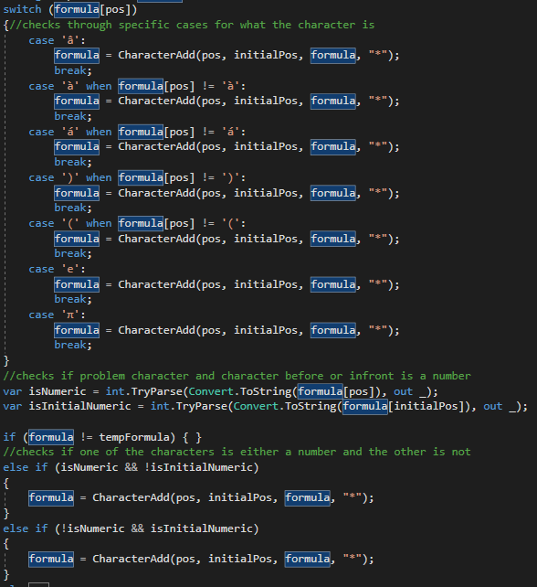
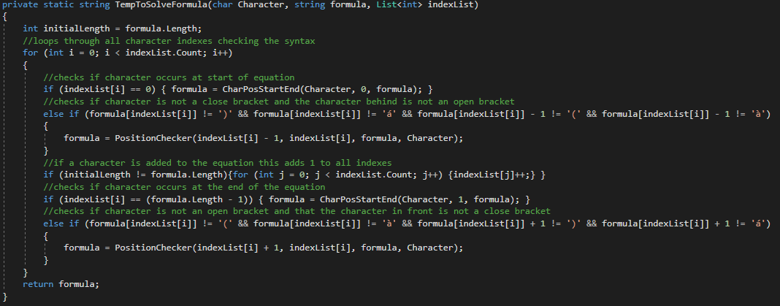
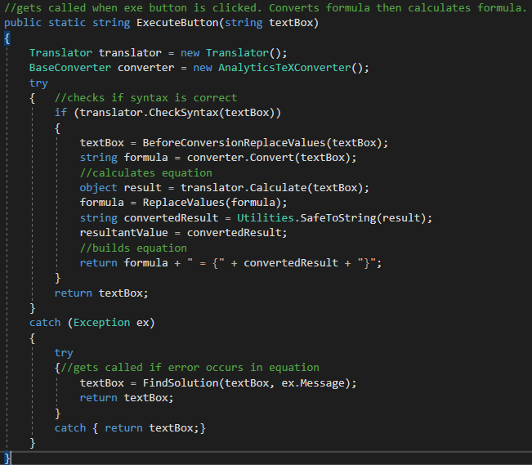
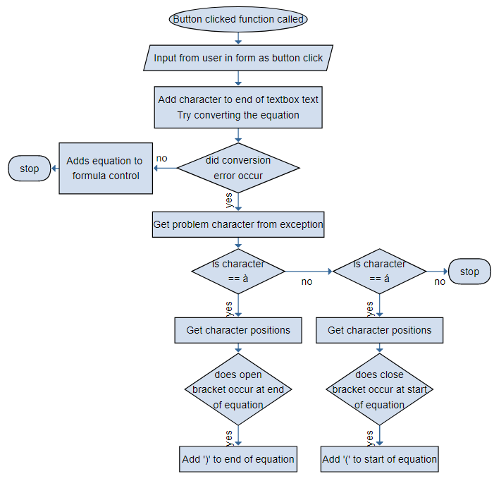
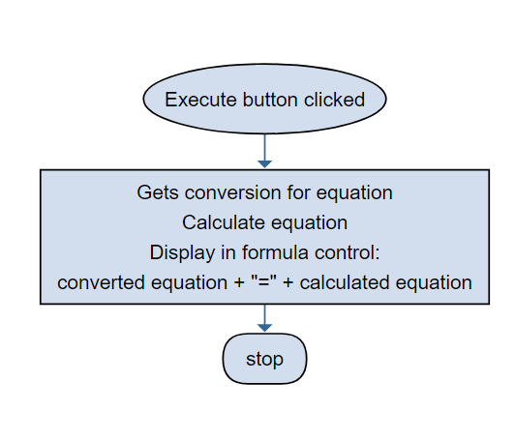
Iteration 5
Another error with the brackets was that multiple multiplication symbols would occur between brackets. The client found that it was not as visually pleasing as what he was hoping for and so I needed to create a solution. The planning of the solution was done through a flowchart which helped in finding the solution which checks whether the character in front was a close bracket or the character behind was an open bracket, if so, it does nothing.
Another feature was updating the execute function. The calculation of the equation was not displaying the answer as the equation was not in correct syntax. A flowchart is used to plan a solution to this issue, it describes that whenever the execute function is called, it tries converting the equation than calculating the answer.

Slide 13
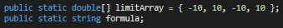
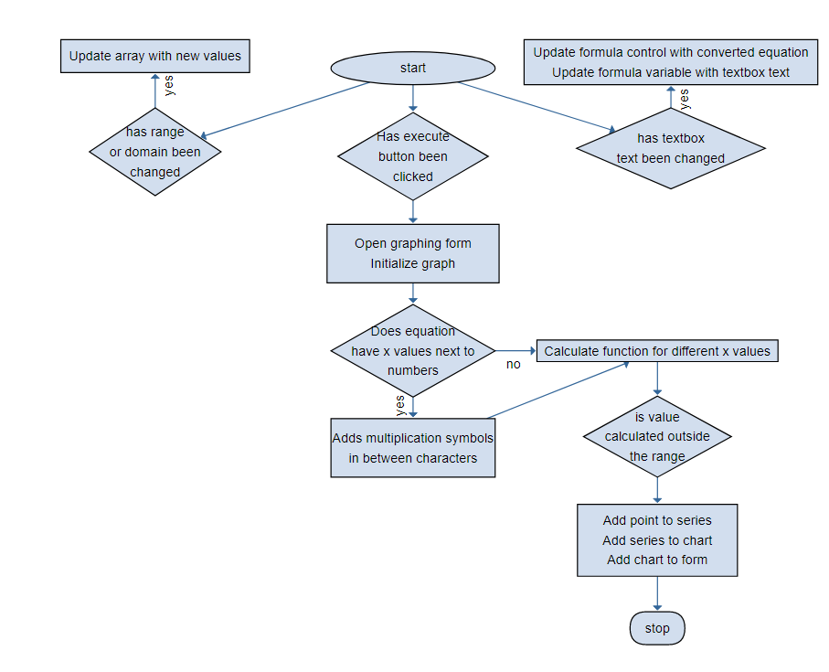
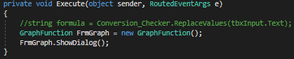
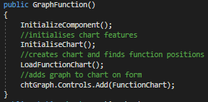
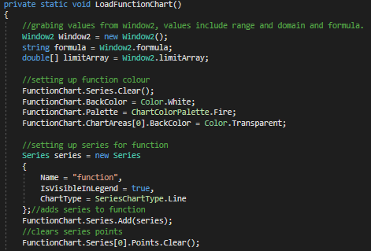
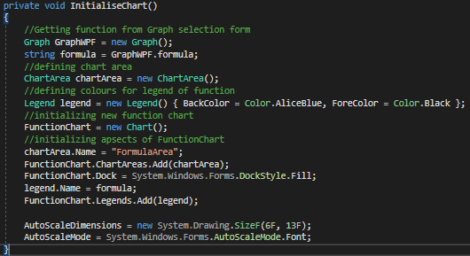
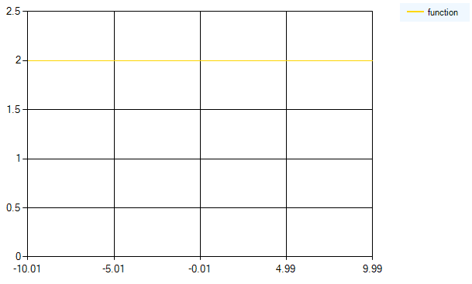
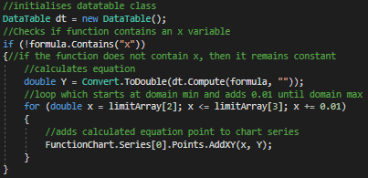
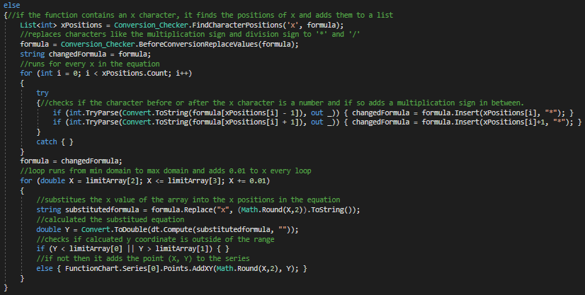
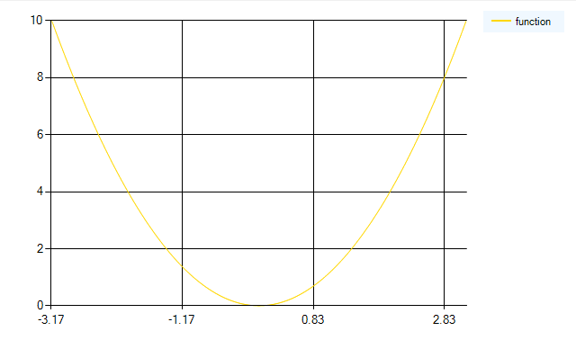
Iteration 6
This feature includes the addition of a graphing system which takes the equation the user has written and displays it on a chart in a different form using the windows data visualization library. The creation of this feature required creating a new window that has a similar aspect to the calculating window but instead of equating an equation, it displays the graph of the equation on a different form. The initial thought process is shown through the flowchart of how the feature will work. The user has the option to change the range and domain of the graph from textboxes on the window. When the player adds characters to the textbox, it still displays the equation in LaTeX formation but as well sets the textbox equation to a public global variable. The max and mins of the range and domain are also stored in a global array. When the execute button is clicked, it calls the graphing form which initializes a line graph and then calls the replaceValues function and adds a multiplication symbol between ‘x’ and any numbers. The points of the graph are added by running a for loop which starts at the minimum domain and ends at the max domain, until it reaches the max domain it adds 0.01 to ‘x’ and calculates the equation with ‘x’. The calculated result is plotted as the ‘y’ coordinate and is displayed on the graph at the position ‘x’, ‘y’. If the calculated ‘y’ values is outside the range it does not get added to the graph series.

Slide 14
Evaluation
The initial design of the calculator had no buttons and consisted of typing into a text box and clicking a button to display the formula in LaTeX. One of my key innovations is adding buttons to help the user with typing math equations as some arguments used in computer calculations have a different character to the mathematical argument which may confuse the user. The use of buttons also allowed for the project to be more effective as it allowed for only specific characters to be entered into the textbox and hence not requiring a function to sort out any miscellaneous characters out of the textbox.
A major innovation with the visual displaying of the equation was to display it when ever the equation text was updated. Initially, the equation would only be displayed in the LaTeX format when the execute button is clicked, this was changed as when typing the equation, it became harder to read in text-based format and allowed for a more visually interactive application which is the clients main purpose of supporting this project.
Another innovation is the use of a class for finding a solution to the conversion errors. Using the class allowed for calling the functions included in the class from multiple different forms. This was especially useful for when creating the graphing application as otherwise I would have needed to create multiple new functions which already existed. The class also helped with the overall efficiency of the code as it limited the number of global variables used throughout the project as they were only initialized inside the class and then removed from memory.
The graphing feature added was another major innovation as it allowed for the user to both visually represent their formula in a mathematically way using the LaTeX and also graphically by using the data visualization library in visual studio forms. The user was able to change the range and domain of the function as desired which allowed for the visualization of larger types of functions. The code used to display the graph was efficient and made use of the text-based equation inside the textbox, where instead of when converting to LaTeX, it only required the addition of replacing symbols and adding multiplication symbols between the ‘x’ variable and numbers.

